Slide 1
Circulatory System
-THE LYMPHATIC AND
IMMUNE SYSTEMS
Al-Farabi Kazakh National University
Higher School of Medicine

Slide 2
PART I

Slide 3
LEARNING OUTCOMES
As a result of the lesson you will be able to:
list the functions of the lymphatic system;
explain how lymph forms and returns to the bloodstream;
name the major cells of the lymphatic system and state their functions;
name and describe the types of lymphatic tissue; and
describe the structure and function of the red bone marrow, thymus, lymph nodes, tonsils, and spleen.
Al-Farabi Kazakh National University
Higher School of Medicine

Slide 4
Pre-tests
1)What is the function of the lymphatic system:
a) ensures the return of proteins, fats and water to the blood
b) transports oxygen and carbon dioxide
c) transports decay products
2)The inner lining of the lymphatic vessels is lined with:
a) ciliated epithelium
b) single-layer prismatic epithelium
c) endothelium
3)The presence of a large number of valves is typical for:
a) blood vessels
b) lymphatic vessels
c) both options are correct
4)The only lymphatic organ with both afferent and efferent lymphatic vessels is
a. the spleen.
b. a lymph node.
c. a tonsil.
d. a Peyer patch.
e. the thymus.
5) The movement of leukocytes through a capillary or venule wall is called _______.

Slide 5
answers: 1) а; 2)с; 3)b; 4)b; 5) diapedesis (emigration).

Slide 6
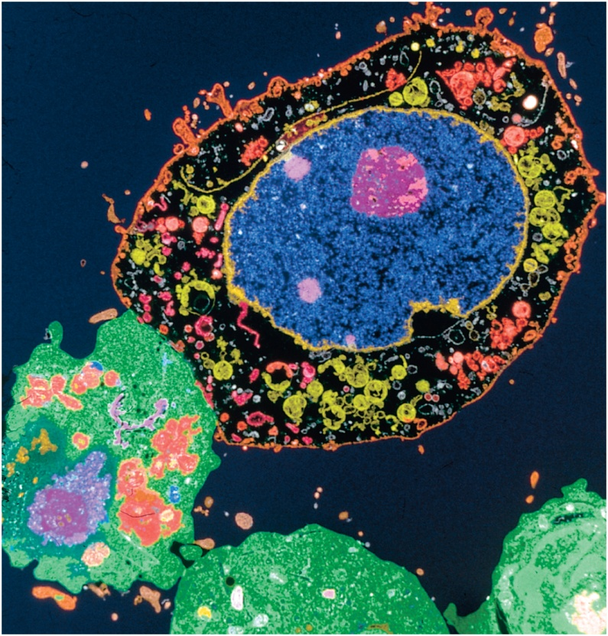
Lymphatic and Immune Systems
the body harbors about 10,000 times as many bacterial cells as human cells
some beneficial
some potentially disease causing
immune system – not an organ system, but a population of cells that inhabit all of our organs and defend the body from agents of disease
especially concentrated in the true organ system – lymphatic system
network of organs and vein-like vessels that recover fluid
inspect it for disease agents
activate immune responses
return the fluid to the bloodstream

Slide 7
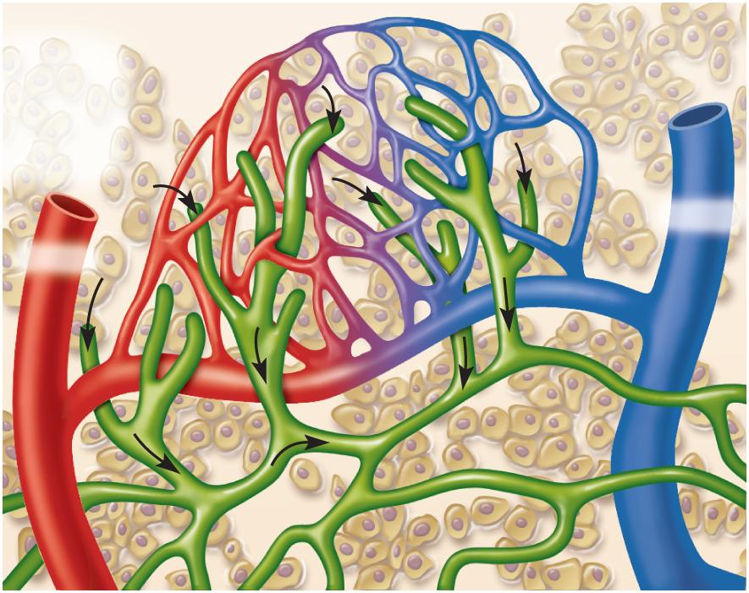
Lymphatic and Immune Systems
Copyright © The McGraw-Hill Companies, Inc. Permission required for reproduction or display.
Capillary bed
Tissue fluid
Tissue cell
Lymphatic
capillary
Venule
Arteriole
Figure 21.3a
(a)
maintain fluid balance
protect body from infection and disease

Slide 8
Functions of Lymphatic System
fluid recovery
fluid continually filters from the blood capillaries into the tissue spaces
blood capillaries reabsorb 85%
15% (2 – 4 L/day) of the water and about half of the plasma proteins enters lymphatic system and then returned to the blood
immunity
excess filtered fluid picks up foreign cells and chemicals from the tissues
passes through lymph nodes where immune cells stand guard against foreign matter
activate a protective immune response
lipid absorption
lacteals in small intestine absorb dietary lipids that are not absorbed by the blood capillaries

Slide 9
Components of the Lymphatic System
lymph
the recovered fluid
lymphatic vessels
transport the lymph
lymphatic tissues
composed of aggregates of lymphocytes and macrophages that populate many organs in the body
lymphatic organs
defense cells are especially concentrated in these organs
separated from surrounding organs by connective tissue capsules

Slide 10
Lymph and Lymphatic Capillaries
lymph
clear, colorless fluid, similar to plasma, but much less protein
extracellular fluid drawn into lymphatic capillaries
lymphatic capillaries (terminal lymphatics)
penetrate nearly every tissue of the body
absent from central nervous system, cartilage, cornea, bone and bone marrow
sacs of thin endothelial cells that loosely overlap each other
closed at one end
cells tethered to surrounding tissue by protein filaments
gaps between cells are large enough to allow bacteria and cells entrance to lymphatic capillary
endothelium creates valve-like flaps that open when interstitial fluid pressure is high, and close when it is low

Slide 11
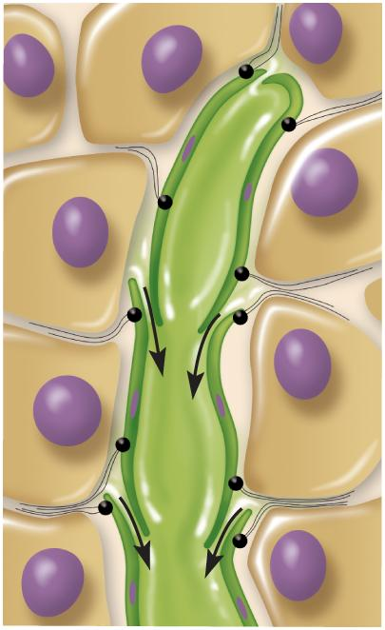
Lymphatic Capillary
Copyright © The McGraw-Hill Companies, Inc. Permission required for reproduction or display.
Lymph
Opening
Tissue
fluid
Endothelium
of lymphatic
capillary
Anchoring
filaments
(b)
Figure 21.3b

Slide 12
▶▶▶ APPLY WHAT YOU KNOW
Why can metastasizing cancer cells get into the lymphatic system more easily than they can enter the bloodstream?

Slide 13
Lymphatic Vessels
larger ones composed of three layers
tunica interna: endothelium and valves
tunica media: elastic fibers, smooth muscle
tunica externa: thin outer layer
converge into larger and larger vessels
What would be the consequence if these valves did not exist?

Slide 14
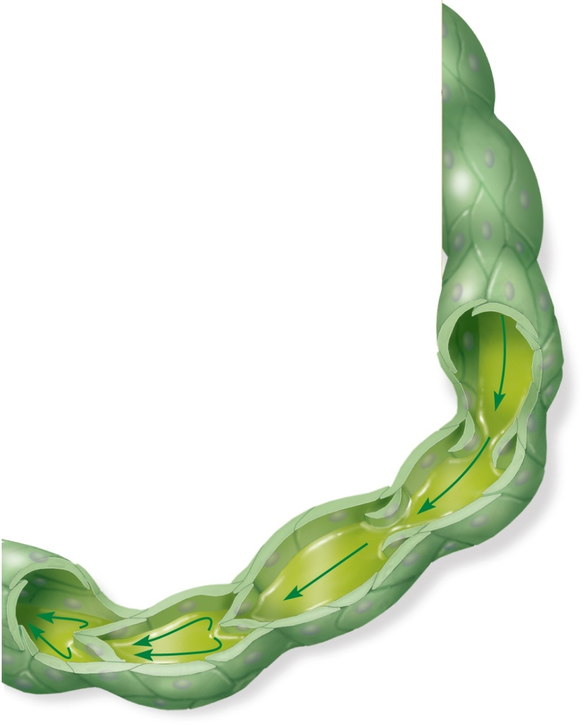
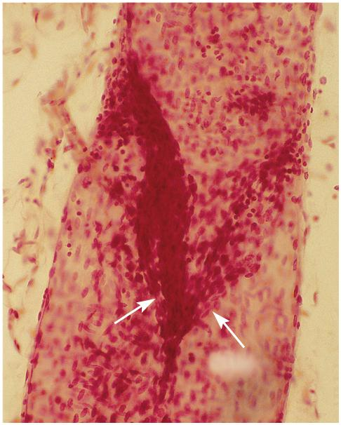
Valve in a Lymphatic Vessel
Copyright © The McGraw-Hill Companies, Inc. Permission required for reproduction or display.
Lymph
Lymph flows
forward through
open valves
Valve
Closed valves
prevent backflow
(a)
(b)
© The McGraw-Hill Companies, Inc./Dennis Strete, photographer
Figure 21.4a
Figure 21.4b

Slide 15
Route of Lymph Flow
lymphatic capillaries
collecting vessels: course through many lymph nodes
six lymphatic trunks: drain major portions of body
two collecting ducts:
right lymphatic duct – receives lymph from right arm, right side of head and thorax; empties into right subclavian vein
thoracic duct - larger and longer, begins as a prominent sac in abdomen called the cisterna chyli; receives lymph from below diaphragm, left arm, left side of head, neck, and thorax; empties into left subclavian vein
subclavian veins

Slide 16
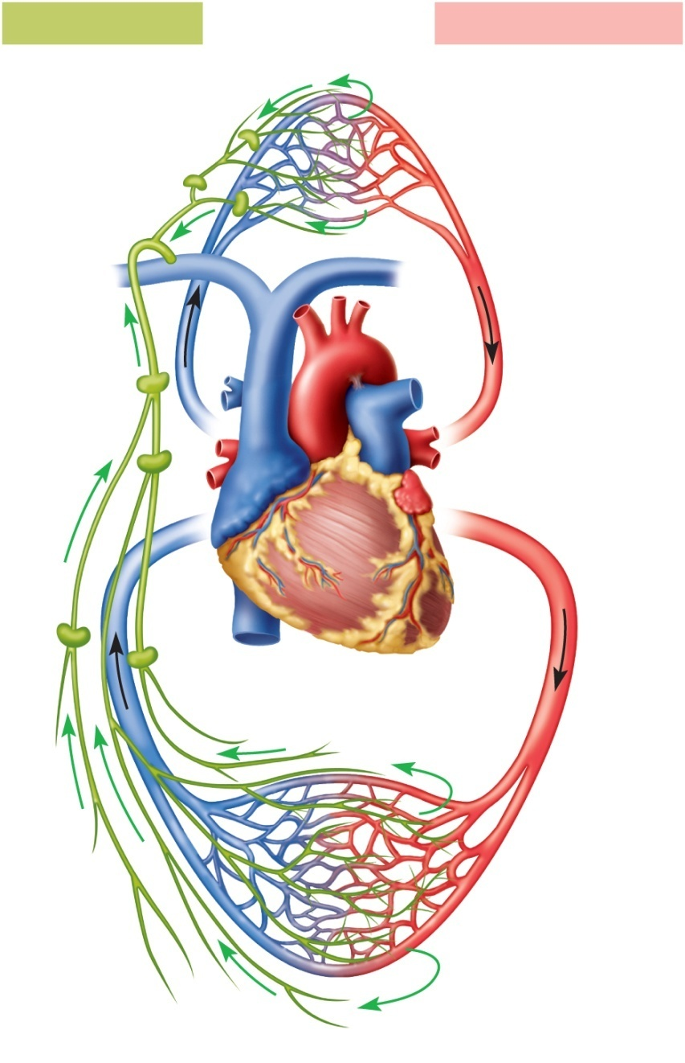
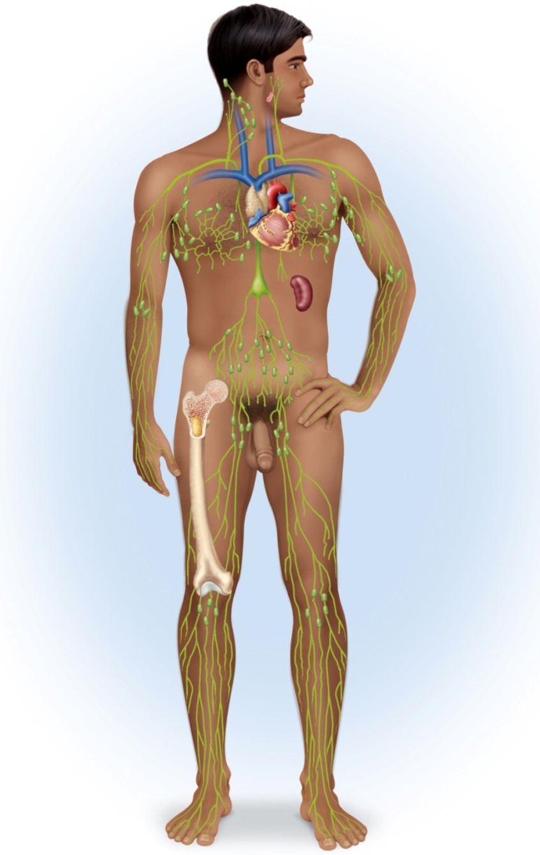
The Fluid Cycle
Copyright © The McGraw-Hill Companies, Inc. Permission required for reproduction or display.
Lymphatic system
Cardiovascular system
Lymphatic
capillaries
Cervical lymph nodes
Palatine tonsil
Pulmonary
circuit
L. internal jugular v.
Lymph
nodes
R. lymphatic duct
Thoracic duct
Lymphatic
trunks
Thymus
Axillary lymph node
Collecting
duct
Subclavian vein
Thoracic duct
Cisterna chyli
Spleen
Abdominal,
intestinal,
and mesenteric
lymph nodes
R. and l. lumbar trunks
Superior
vena cava
Intestinal trunk
Collecting
vessels
Red bone marrow
Inguinal lymph nodes
Blood
flow
Lymph
flow
Popliteal lymph nodes
Systemic
circuit
Lymphatic vessels
Lymphatic
capillaries
Figure 21.5
Figure 21.1

Slide 17
▶▶▶ APPLY WHAT YOU KNOW
Identify two benefits in having lymphatic capillaries pick up tissue fluid that is not reclaimed by the blood capillaries.

Slide 18
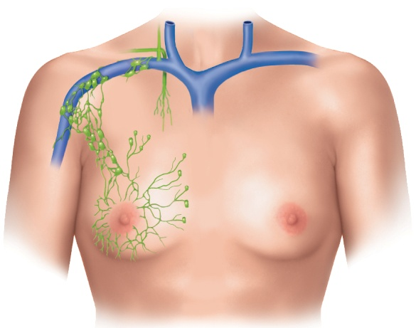
Lymphatic Drainage of Mammary and Axillary Regions
Why are the axillary lymph nodes often biopsied in cases of suspected breast cancer?
Copyright © The McGraw-Hill Companies, Inc. Permission required for reproduction or display.
Right lymphatic duct
Right subclavian
vein
Axillary lymph
nodes
Lymphatics
of breast
(b)
Figure 21.6b

Slide 19
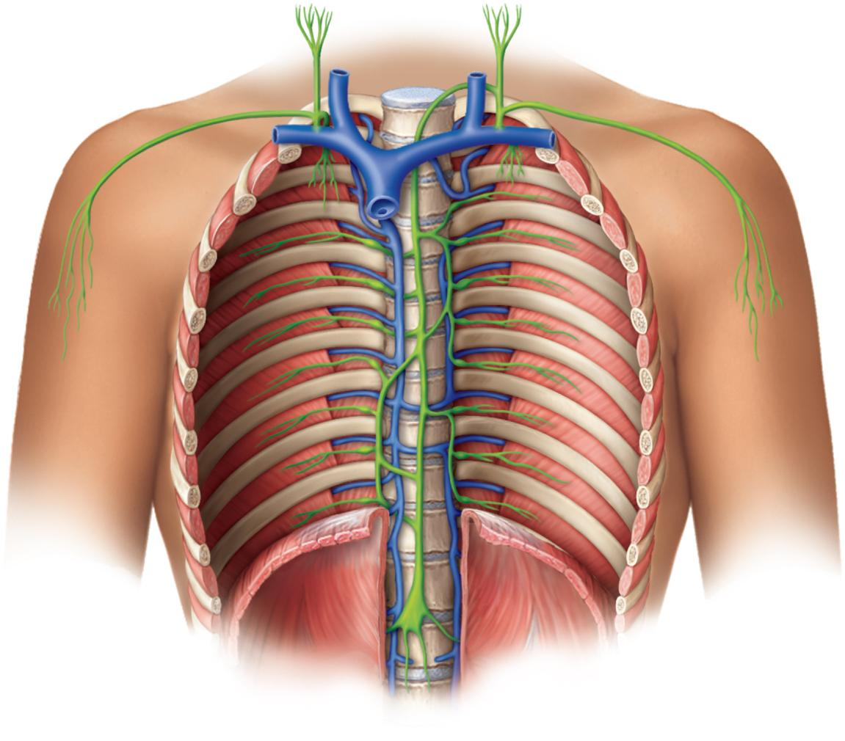
Drainage of Thorax
Copyright © The McGraw-Hill Companies, Inc. Permission required for reproduction or display.
Internal
jugular veins
Right jugular trunk
Left jugular trunk
Right lymphatic duct
Thoracic duct
Right subclavian trunk
Left subclavian
trunk
Right
bronchio-
mediastinal
trunk
Left
bronchiomediastinal
trunk
Azygos vein
Thoracic duct
Thoracic lymph
nodes
Hemiazygos vein
Diaphragm
Cisterna chyli
Intestinal trunk
Right lumbar trunk
Left lumbar trunk
(a)
Figure 21.6a

Slide 20
Mechanisms of Lymph Flow
lymph flows under forces similar to those that govern venous return, except no pump (heart)
lymph flows at low pressure and slower speed than venous blood
moved along by rhythmic contractions of lymphatic vessels
stretching of vessels stimulates contraction
flow aided by skeletal muscle pump
arterial pulsation rhythmically squeeze lymphatic vessels
thoracic pump aids flow from abdominal to thoracic cavity
valves prevent backward flow
rapidly flowing blood in subclavian veins, draws lymph into it
exercise significantly increases lymphatic return

Slide 21
▶▶▶ APPLY WHAT YOU KNOW
Contrast the structure of a lymphatic capillary with that of a continuous blood capillary. Explain why their structural difference is related to their functional difference.

Slide 22
Lymphatic Cells
natural killer (NK) cells
large lymphocytes that attack and destroy bacteria, transplanted tissue, host cells infected with viruses or have turned cancerous
responsible for immune surveillance
T lymphocytes (T cells)
mature in thymus
B lymphocytes (B cells)
activation causes proliferation and differentiation into plasma cells that produce antibodies

Slide 23
Lymphatic Cells
macrophages
very large, avidly phagocytic cells of the connective tissue
develop from monocytes
phagocytize tissue debris, dead neutrophils, bacteria, and other foreign matter
process foreign matter and display antigenic fragments to certain T cells alerting the immune system to the presence of the enemy
antigen presenting cells (APCs)
dendritic cells
branched, mobile APCs found in epidermis, mucous membranes, and lymphatic organs
alert immune system to pathogens that have breached their surface
reticular cells
branched stationary cells that contribute to the stroma of a lymphatic organ
act as APCs in the thymus

Slide 24
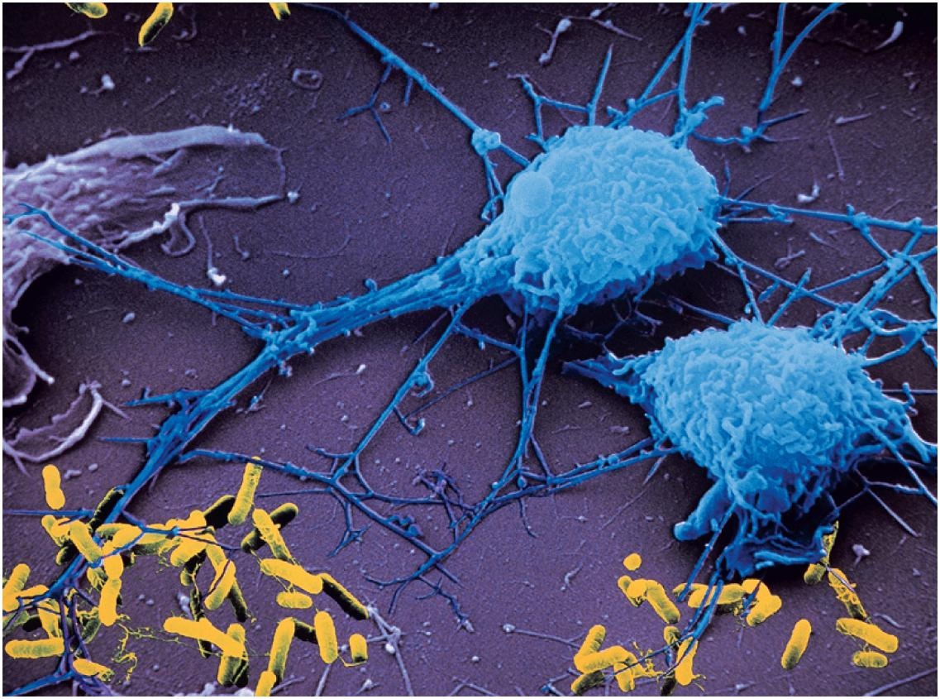
Macrophages
Copyright © The McGraw-Hill Companies, Inc. Permission required for reproduction or display.
Macrophages
Pseudopods
Bacteria
5 µm
Peter Arnold, Inc.
Figure 21.7

Slide 25
Lymphatic Tissue
lymphatic (lymphoid) tissue – aggregations of lymphocytes in the connective tissues of mucous membranes and various organs
diffuse lymphatic tissue – simplest form
lymphocytes are scattered, rather than densely clustered
prevalent in body passages open to the exterior
respiratory, digestive, urinary, and reproductive tracts
mucosa-associated lymphatic tissue (MALT)
lymphatic nodules (follicles)
dense masses of lymphocytes and macrophages that congregate in response to pathogens
constant feature of the lymph nodes, tonsils, and appendix
Peyer patches – dense clusters in the ileum, the distal portion of the small intestine

Slide 26
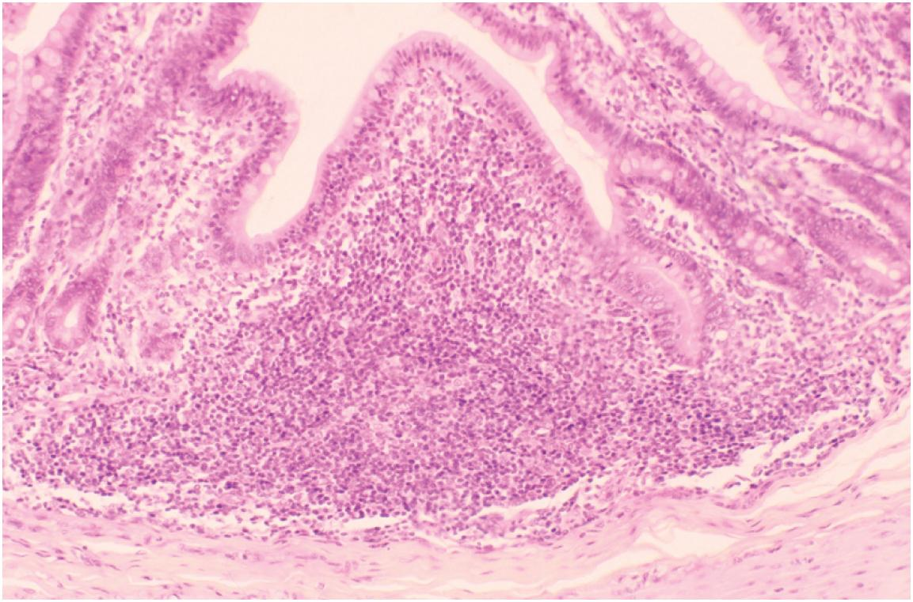
Lymphatic Nodule
Copyright © The McGraw-Hill Companies, Inc. Permission required for reproduction or display.
Intestinal villus
Lymphatic
nodule
Custom Medical Stock Photo
Figure 21.8

Slide 27
Lymphatic Organs
lymphatic organs have well-defined anatomical sites
have connective tissue capsule that separates the lymphatic tissue from neighboring tissues
primary lymphatic organs
red bone marrow and thymus
site where T and B cells become immunocompetent – able to recognize and respond to antigens
secondary lymphatic organs
lymph nodes, tonsils, and spleen
immunocompetent cells populate these tissues

Slide 28
Red Bone Marrow
red bone marrow is involved in hemopoiesis (blood formation) and immunity
soft, loosely organized, highly vascular material
separated from osseous tissue by endosteum of bone
as blood cells mature, they push their way through the reticular and endothelial cells to enter the sinus and flow away in the blood stream

Slide 29
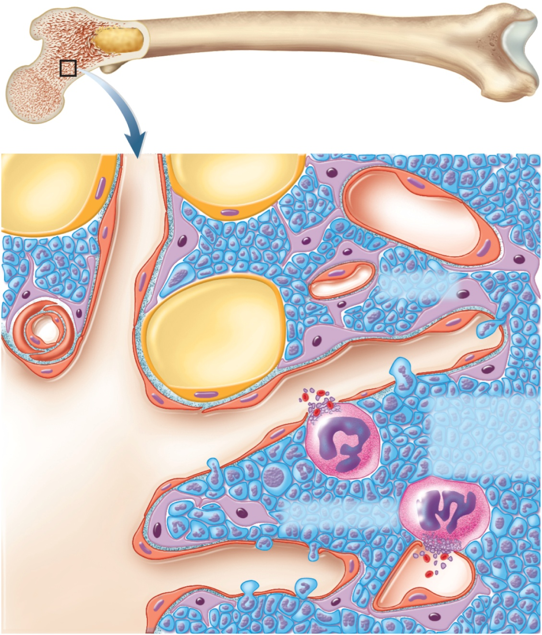
Histology of Red Bone Marrow
Copyright © The McGraw-Hill Companies, Inc. Permission required for reproduction or display.
Sinusoid
Capillary
Adipose cell
Artery
Platelets and
blood cell
entering
circulation
Endothelial cells
Sinusoid
Figure 21.9
Reticular cells
Megakaryocyte
Central
longitudinal
vein
Sinusoid

Slide 30
Thymus
thymus – member of the endocrine, lymphatic, and immune systems
houses developing lymphocytes
secretes hormones regulating their activity
bilobed organ located in superior mediastinum between the sternum and aortic arch
degeneration or involution with age
fibrous capsule gives off trabeculae (septa) that divide the gland into several lobes
lobes have cortex and medulla populated by T lymphocytes
reticular epithelial cells seal off cortex from medulla forming blood-thymus barrier
produce signaling molecules thymosin, thymopoietin, thymulin, interleukins, and interferon

Slide 31
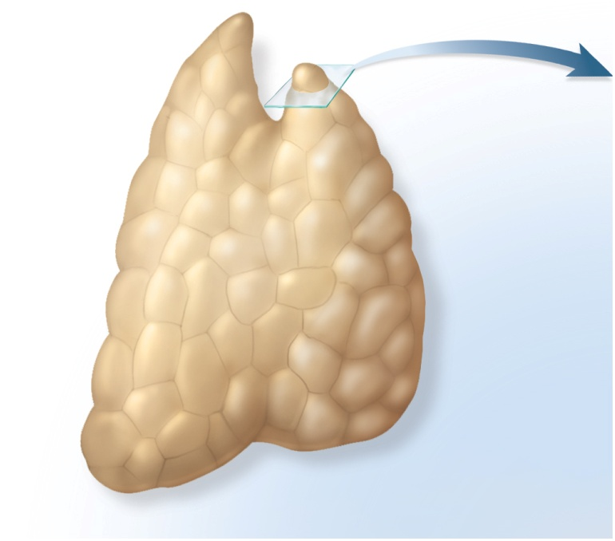
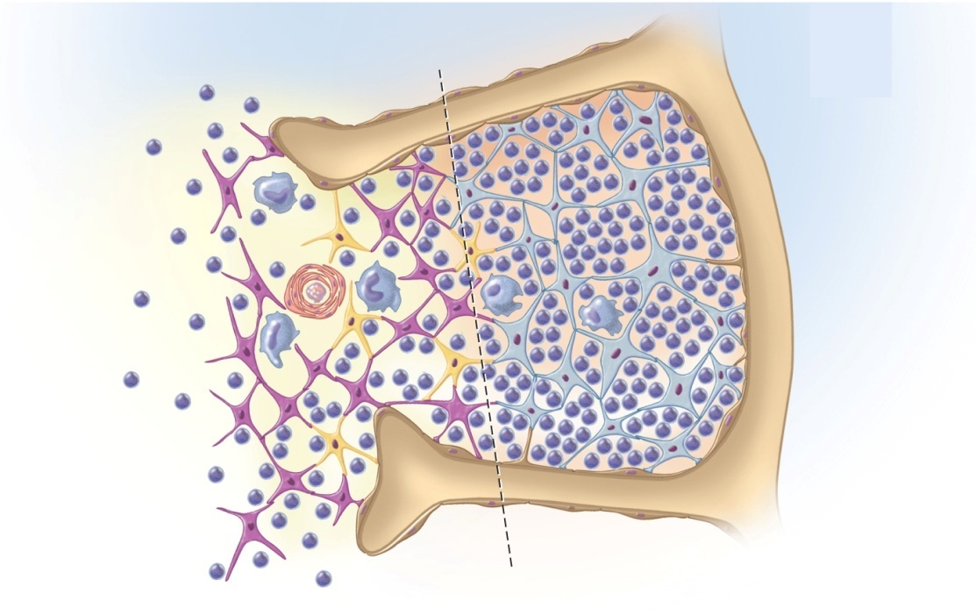
Anatomy of Thymus
Copyright © The McGraw-Hill Companies, Inc. Permission required for reproduction or display.
Right lobe
Left lobe
Reticular epithelial
cells of cortex
Trabecula
T lymphocytes
(thymocytes)
Thymic corpuscle
Macrophage
Lobule
Dendritic cell
Capsule
Reticular epithelial
cells of medulla
Epithelium
Trabecula
(c)
Medulla
Cortex
(a)
Figure 21.10a,c

Slide 32
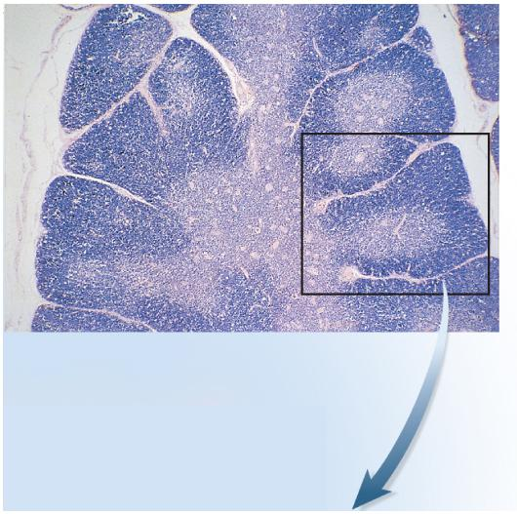
Histology of Thymus
Copyright © The McGraw-Hill Companies, Inc. Permission required for reproduction or display.
Trabecula
Trabecula
Cortex
Lobule
Medulla
(b)
© The McGraw-Hill Companies/Rebecca Gray, photographer/Don Kincaid, dissections
Figure 21.10b

Slide 33
Lymph Node
lymph nodes – the most numerous lymphatic organs
about 450 in typical young adult
serve two functions:
cleanse the lymph
act as a site of T and B cell activation
elongated, bean shaped structure with hilum
enclosed with fibrous capsule with trabeculae that divide interior into compartments
stroma of reticular fibers and reticular cells
parenchyma divided into cortex and medulla
germinal centers where B cells multiply and differentiate into plasma cells
several afferent lymphatic vessels lead into the node along its convex surface
lymph leaves the node through one to three efferent lymphatic vessels that leave the hilum

Slide 34
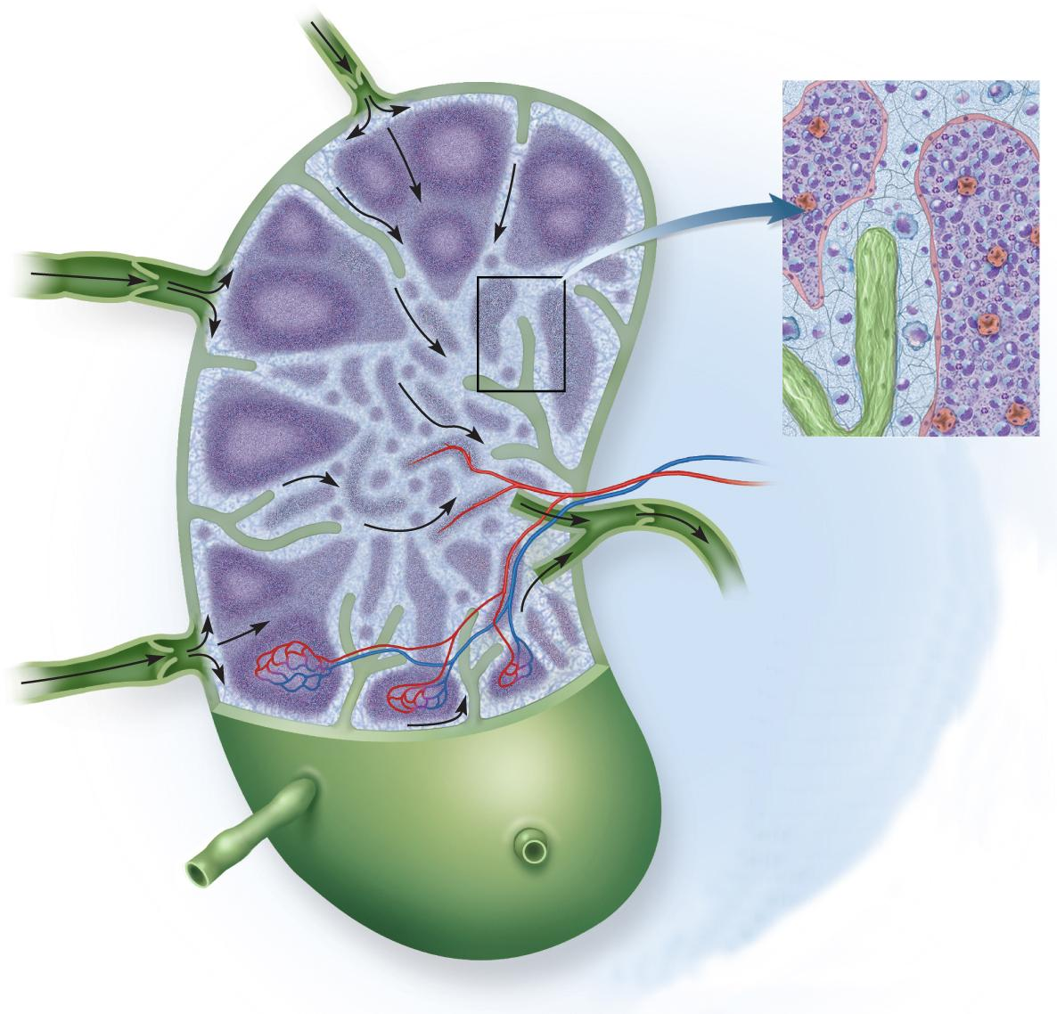
Lymph Node
Copyright © The McGraw-Hill Companies, Inc. Permission required for reproduction or display.
Stroma:
Medullary cords
Capsule
Reticular tissue
Medullary sinus
Trabecula
Macrophage
Trabecula
Lymphocytes
Cortex
Reticular fibers
Subcapsular sinus
Artery
and vein
Lymphatic nodule
Venule
Germinal center
(b)
Cortical sinuses
Medulla
Efferent
lymphatic
vessel
Medullary sinus
Medullary cord
Afferent lymphatic
vessels
(a)
Figure 21.12a,b

Slide 35
Lymph Node Locations
cervical lymph nodes
deep and superficial group in the neck
monitor lymph coming from head and neck
axillary lymph nodes
concentrated in armpit
receive lymph from upper limb and female breast
thoracic lymph nodes
in thoracic cavity especially embedded in mediastinum
receive lymph from mediastinum, lungs, and airway

Slide 36
Lymph Node Locations
abdominal lymph nodes
occur in posterior abdominopelvic wall
monitor lymph from the urinary and reproductive systems
intestinal and mesenteric lymph nodes
found in the mesenteries, adjacent to the appendix and intestines
monitor lymph from the digestive tract
inguinal lymph nodes
in the groin and receive lymph from the entire lower limb
popliteal lymph nodes
occur on the back of the knee
receive lymph from the leg proper

Slide 37
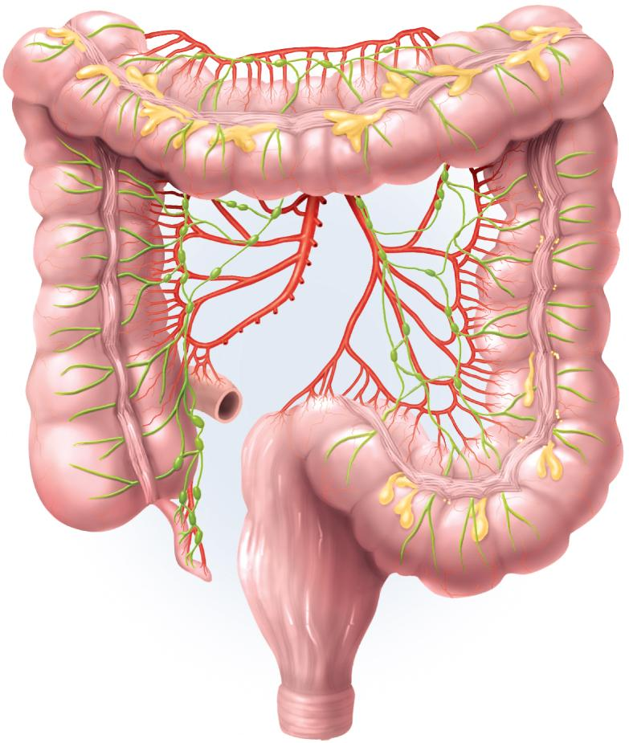
Lymph Node Areas of Concentration
Copyright © The McGraw-Hill Companies, Inc. Permission required for reproduction or display.
Transverse
mesocolic
lymph nodes
Colon
Superior
mesenteric
artery
Superior
mesenteric
lymph nodes
Inferior
mesenteric
artery
Ileocolic
lymph nodes
Inferior
mesenteric
lymph nodes
Small
intestine
Appendicular
lymph nodes
Appendix
Figure 21.11a
(a)

Slide 38
Lymphadenopathy
lymphadenopathy - collective term for all lymph node diseases
lymphadenitis - swollen, painful node responding to foreign antigen
lymph nodes are common sites for metastatic cancer
swollen, firm and usually painless

Slide 39
Lymph Nodes and Metastatic Cancer
metastasis – phenomenon in which cancerous cells break free from the original, primary tumor, travel to other sites in the body, and establish new tumors.
metastasizing cancer cells can easily enter the lymphatic vessels
tend to lodge in the first lymph node they encounter
multiply there and eventually destroy the node
swollen, firm, and usually painless
tend to spread to the next node downstream
treatment of breast cancer is lumpectomy, mastectomy along with removal of nearby axillary nodes

Slide 40
Tonsils
tonsils – patches of lymphatic tissue located at the entrance to the pharynx
guard against ingested or inhaled pathogens
each covered with epithelium
have deep pits – tonsillar crypts lined with lymphatic nodules – tonsillitis and tonsillectomy
three main sets of tonsils
palatine tonsils
pair at posterior margin of oral cavity
most often infected
lingual tonsils
pair at root of tongue
pharyngeal tonsil (adenoid)
single tonsil on wall of nasopharynx

Slide 41
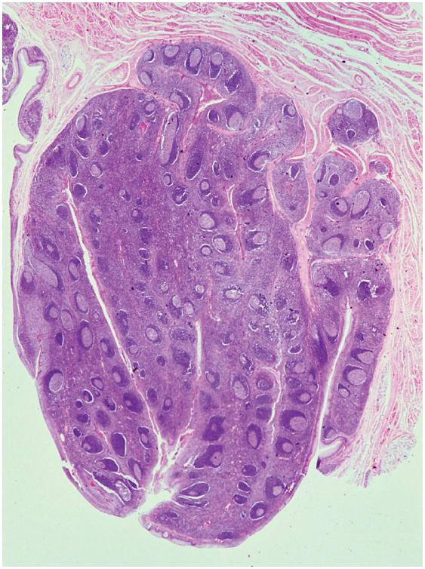
pharyngeal tonsil
Copyright © The McGraw-Hill Companies, Inc. Permission required for reproduction or display.
Tonsillar crypts
Lymphatic
nodules
Pharyngeal
epithelium
Figure 21.13b
(b)
© Biophoto Associates/Photo Researchers, Inc.
covered by epithelium
pathogens get into tonsillar crypts and encounter lymphocytes

Slide 42
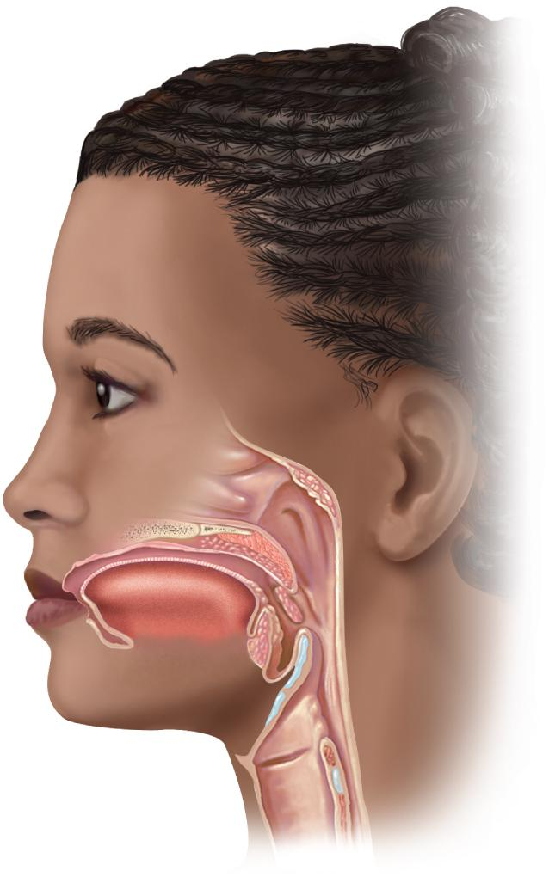
The Tonsils
Copyright © The McGraw-Hill Companies, Inc. Permission required for reproduction or display.
Pharyngeal
tonsil
Palate
Palatine
tonsil
Figure 21.13 a
Lingual
tonsil
(a)

Slide 43
Spleen
spleen – the body’s largest lymphatic organ
parenchyma exhibits two types of tissue:
red pulp - sinuses filled with erythrocytes
white pulp - lymphocytes, macrophages surrounding small branches of splenic artery
functions
blood production in fetus
blood reservoir
‘erythrocyte graveyard’ - RBC disposal
white pulp monitors blood for foreign antigens
spleen highly vascular and vulnerable to trauma and infection
ruptured spleen - splenectomy

Slide 44
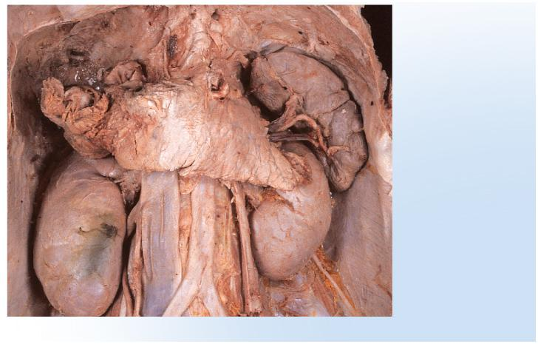
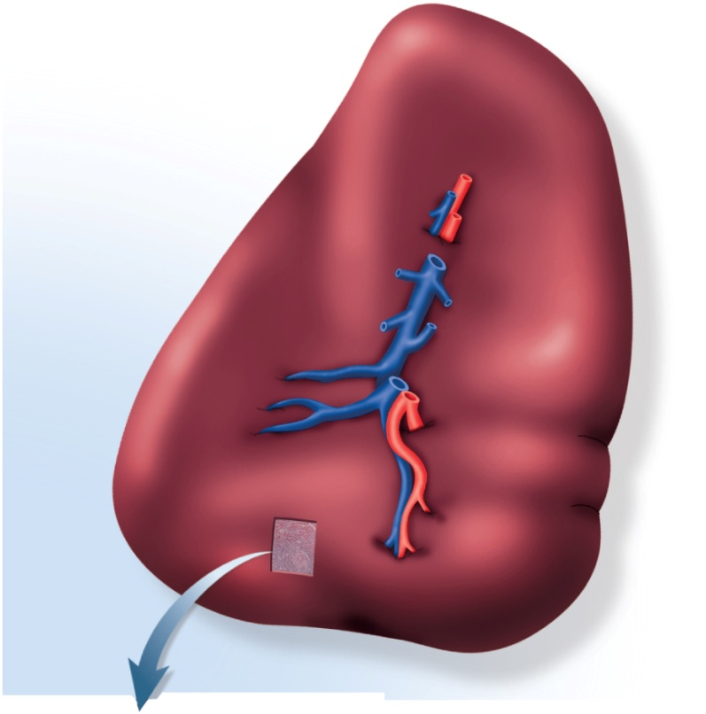
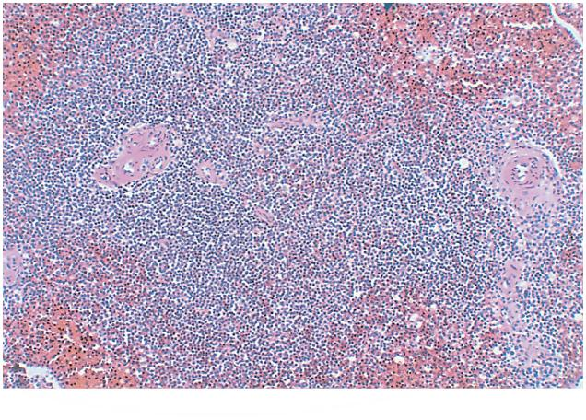
Spleen
Copyright © The McGraw-Hill Companies, Inc. Permission required for reproduction or display.
Diaphragm
Spleen
Splenic artery
Splenic vein
Copyright © The McGraw-Hill Companies, Inc. Permission required for reproduction or display.
Pancreas
Superior
Kidney
Inferior vena
cava
Aorta
Gastric area
Common iliac
arteries
Hilum
(a)
© The McGraw-Hill Companies/Dennis Strete, photographer
Renal area
Figure 21.14a
Copyright © The McGraw-Hill Companies, Inc. Permission required for reproduction or display.
Splenic
vein
Red pulp
Splenic
artery
Central artery
(branching)
(b)
Inferior
White pulp
Figure 21.14b
(c)
Figure 21.14c
© The McGraw-Hill Companies, Inc./Photo by Dr. Alvin Telser

Slide 45
1)The lymphatic system serves to:
a) return of substances from tissue fluid to blood
b) providing an immune response to infection
c) supplying organs with oxygen
2) Which of the following cells are involved in innate immunity but not in adaptive immunity?
a) helper T cells; b)cytotoxic T cells; c)natural killer cells; d)B cells; e)plasma cells.
3)The respiratory burst is used by______ kill bacteria.
a. neutrophils
b. basophils
c. mast cells
d. NK cells
e. cytotoxic T cells
4)Self-tolerance results from a process called _____, in which lymphocytes programmed to react against self-antigens die.
5)Which of these is a macrophage?
a. a microglial cell
b. a plasma cell
c. a reticular cell
d. a helper T cell e. a mast cell

Slide 46
answers*
1)a;
2)c;
3)a;
4)clonal deletion;
5)a;

